Slide 1
Digital Logic Design
Lecture 11

Slide 2
Don’t Care Conditions
The minterms of a Boolean function specify all combinations of variable values for which the function is equal to 1. The function is assumed to be equal to 0 for the rest of the minterms.
This assumption, however, is not always valid, since there are applications in which the function is not specified for certain variable value combinations.
There are two cases in which this occurs.
In the first case, the input combinations never occur. As an example, the four-bit binary code for the decimal digits has six combinations that are not used and not expected to occur.
In the second case, the input combinations are expected to occur, but we do not care what the outputs are in response to these combinations.

Slide 3
Contd.
In both cases, the outputs are said to be unspecified for the input combinations.
Incompletely specified functions
Functions that have unspecified outputs for some input combinations are called incompletely specified functions.
In most applications, we simply do not care what value is assumed by the function for the unspecified minterms. For this reason, it is customary to call the unspecified minterms of a function don’t-care conditions.
These conditions can be used on a map to provide further simplification of the function.

Slide 4
Contd.
It should be realized that a don’t-care minterm cannot be marked with a 1 on the map, because that would require that the function always be a 1 for such a minterm.
Likewise, putting a 0 in the square requires the function to be 0.
To distinguish the don’t-care condition from 1s and 0s, an X is used.
Simplification of an incompletely specified function
When choosing adjacent squares to simplify the function in the map, the ×’s may be assumed to be either 0 or 1, whichever gives the simplest expression.
An × need not be used at all if it does not contribute to covering a larger area.

Slide 5
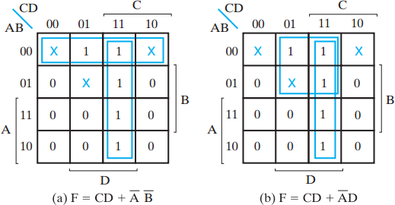
Example 2.14
Simplify the Boolean function F (A, B, C, D) = Σm(1,3,7,11,15)
which has the don’t-care conditions d (A, B, C, D) = Σm(0,2,5).
SOP: F= C D + A B, F= C D + A D
It is also possible to obtain an optimized product-of-sums expression for the function.
POS: In this case, the way to combine the 0s is to include don’t-care minterms 0 and 2 with the 0s, giving the optimized complemented function.
F = D + A C
Taking the complement of F
F = D(A + C)

Slide 6
Exclusive OR/ Exclusive NOR
The eXclusive OR (XOR) function is an important Boolean function used extensively in logic circuits.
The XOR function may be;
implemented directly as an electronic circuit (truly a gate) or
implemented by interconnecting other gate types (used as a convenient representation)
The eXclusive NOR function is the complement of the XOR function
By definition, XOR and XNOR gates are complex gates.

Slide 7
Exclusive OR/ Exclusive NOR
Uses for the XOR and XNORs gate include:
Adders/subtractors/multipliers
Counters/incrementers/decrementers
Parity generators/checkers
Definitions
The XOR function is:
X ⊕ Y = X Y + X Y
The eXclusive NOR (XNOR) function, otherwise
known as equivalence is:
X ⊕ Y = X Y + X Y
Strictly speaking, XOR and XNOR gates do no exist for more than two inputs. Instead, they are replaced by odd and even functions.

Slide 8
Truth Tables for XOR/XNOR
Operator Rules: XOR XNOR
X | Y | X⊕Y
0 | 0 | 0
0 | 1 | 1
1 | 0 | 1
1 | 1 | 0
X | Y | (X⊕Y) or X≡Y
0 | 0 | 1
0 | 1 | 0
1 | 0 | 0
1 | 1 | 1
The XOR function means:
X OR Y, but NOT BOTH
Why is the XNOR function also known as the
equivalence function, denoted by the operator ≡?

Slide 9
XOR/XNOR (Continued)
The XOR function can be extended to 3 or more variables. For more than 2 variables, it is called an odd function or modulo 2 sum (Mod 2 sum), not an XOR:
X ⊕ Y ⊕ Z = X Y Z + X Y Z + X Y Z + X Y Z
The complement of the odd function is the even function.
The XOR identities:
X ⊕ 0 = X
X ⊕ X = 0
X ⊕ 1 = X
X ⊕ X = 1
X ⊕ Y = Y ⊕ X
(X ⊕ Y) ⊕ Z = X ⊕ (Y ⊕ Z) = X ⊕ Y ⊕ Z

Slide 10

Symbols For XOR and XNOR
XOR symbol:
XNOR symbol:
Shaped symbols exist only for two inputs

Slide 11
XOR Implementations
The simple SOP implementation uses the following structure:
X
X
Y
Y
A NAND only implementation is:
X
X
Y
Y

Slide 12
Odd and Even Functions
The odd and even functions on a K-map form “checkerboard” patterns.
The 1s of an odd function correspond to minterms having an index with an odd number of 1s.
The 1s of an even function correspond to minterms having an index with an even number of 1s.
Implementation of odd and even functions for greater than four variables as a two-level circuit is difficult, so we use “trees” made up of :
2-input XOR or XNORs
3- or 4-input odd or even functions

Slide 13
Example: Odd Function Implementation
Design a 3-input odd function F = X + Y + Z with 2-input XOR gates
Factoring, F = (X + Y) + Z
The circuit:
X Y
Z
F

Slide 14

Example: Even Function Implementation
Design a 4-input odd function F = W + X + Y + Z with 2-input XOR and XNOR gates
Factoring, F = (W + X) + (Y + Z)
Implementation of even function using odd inputs
The circuit:
W X
F
Y
Z

Slide 15
Parity Generators/ Checkers
In Chapter 1, a parity bit added to n-bit code to produce an n + 1 bit code:
Add odd parity bit to generate code words with even parity
Add even parity bit to generate code words with odd parity
Use odd parity circuit to check code words with even parity
Use even parity circuit to check code words with odd parity
Example: n = 3. Generate even parity code words of length four with odd parity generator:
Check even parity code words of length four with odd parity checker:
Operation: (X,Y,Z) = (0,0,1) gives (X,Y,Z,P) = (0,0,1,1)
and E = 0. If Y changes from 0 to 1 between generator and checker, then E = 1 indicates an error.
X Y
Z X Y
P
E
Z P

Slide 16
Implementing functions with only OR and NOT gates
F = AB’C + A’C’ + AB
F = AB’C + A’C’ + AB
F = AB’C . A’C’ . AB
By De Morgan's Laws
F = (A’+ B + C’) . (A + C) . (A’+ B’)
F = (A’+ B + C’) + (A + C) + (A’+ B’)

Slide 17
Implementing functions with only AND and NOT gates
F = (A+B’+C) . (A’+B+C) . (A’+C) . (B+C’)
F = (A+B’+C) . (A’+B+C) . (A’+C) . (B+C’)
F = (A+B’+C) + (A’+B+C) + (A’+C) + (B+C’)
F = (A’.B.C’) + (A.B’.C’) + (A.C’) + (B’.C)
F = (A’.B.C’) . (A.B’.C’) . (A.C’) . (B’.C)

Slide 18
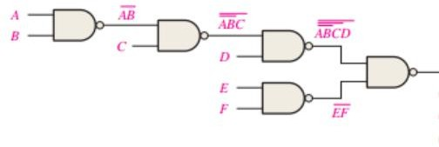
Implementation using only NAND Gate: F=(AB + C’)D + EF

Slide 19
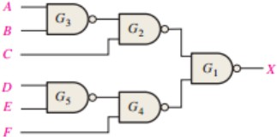
Example 2: F = (A’+B’)C + (D’+E’)F

Slide 20
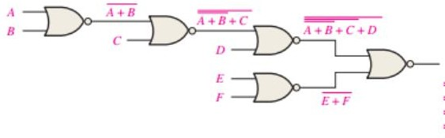
Implementation using only NOR Gates: F = ((A+B)C’+ D) (E+F)

Slide 21
Combinational Circuits
A combinational logic circuit has:
A set of m Boolean inputs,
A set of n Boolean outputs, and
n switching functions, each mapping the 2^{m} input combinations to an output such that the current output depends only on the current input values
A block diagram:
Combinatorial Logic
Circuit
m Boolean Inputs
n Boolean Outputs
Chapter 3 - Part 1
21

Slide 22

Combinational Circuits
A B C
A B C
A B
?
F₁
Analysis
Given a circuit, find out its function
Function may be expressed as:
Boolean function
Truth table
Design
Given a desired function, determine its circuit
Function may be expressed as:
Boolean function
Truth table
?
A C
B C
F₂
?

Slide 23
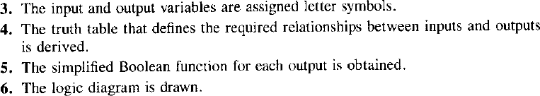
Design Procedure
Chapter 3 - Part 1
23

Slide 24
Design Procedure
Specification
Write a specification for the circuit if one is not already available
Formulation
Derive a truth table or initial Boolean equations that define the required relationships between the inputs and outputs, if not in the specification
Apply hierarchical design if appropriate
Optimization
Apply 2-level and multiple-level optimization
Draw a logic diagram or provide a netlist for the resulting circuit using ANDs, ORs, and inverters
Chapter 3 - Part 1
24

Slide 25
Design Procedure
Technology Mapping
Map the logic diagram or netlist to the implementation technology selected
Verification
Verify the correctness of the final design manually or using simulation
Chapter 3 - Part 1
25

Slide 26
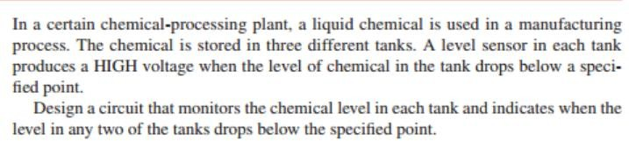
Example: Design a circuit diagram
Chapter 3 - Part 1
26

Slide 27
Chapter 3 - Part 1
27

